Slide 1


ILORIN INNOVATION HUB
A Marketing & Strategic Communication Plan

Slide 2
SITUATION AND CONTEXT

Slide 3
INTRODUCTION
The rise of digital transformation has propelled innovation hubs to center stage in driving national and regional social and economic development. These dynamic ecosystems serve as launchpads for burgeoning startups, fostering a collaborative environment for experimentation, talent acquisition, and the development of technology-driven solutions.
The Ilorin Innovation Hub:
Situated within the burgeoning Nigerian innovation landscape, the Ilorin Innovation Hub plays a pivotal role in nurturing early-stage startups. While its focus may extend beyond purely tech-driven ventures, the hub recognizes the crucial role technology plays in empowering solutions across sectors like agriculture, education, and healthcare.
Building a reputation

Slide 4
SOCIO-ECONOMIC BENEFITS OF HUBS
Fostering job creation by supporting startups that create new businesses and employment opportunities across the country
Equipping individuals with entrepreneurial skills and knowledge through workshops and mentorship programs
Potential exists for the hub to support startups tackling social challenges in education, healthcare, or poverty alleviation
The hub strengthens the entrepreneurial ecosystem contributing to economic diversification
Fostering startup growth can lead to increased investment, innovation, and economic activity within the state and beyond

Slide 5
TRENDS WITHIN THE ECOSYSTEM
Focus on Tech-Enabled Solutions: There's a growing trend towards tech-enabled solutions addressing local challenges in areas like agriculture, education, and healthcare.
Increased Investor Interest: Investment in Nigerian startups is on the rise, attracting both local and international venture capital firms.
Demand for Tech Skills: The growing technology sector in Nigeria is driving demand for tech skills and training, which innovation hubs addresses through its programs.
Increased Government Support: Initiatives like the Nigeria Startup Bill 2022 and government initiatives and private organizations are increasingly supporting youth entrepreneurship
Focus on Youth and Inclusion: Programs targeting young people and promoting inclusion for women and underrepresented groups are gaining traction.
Demand for Local Solutions: There's a growing need for locally-developed solutions addressing challenges in agriculture, clean energy, and healthcare.
Emerging technologies like artificial intelligence, blockchain, and Internet of Things (IoT) have the potential to revolutionize various sectors.
The rise of remote work offers opportunities for hubs to connect with talent and startups beyond geographical limitations.

Slide 6
THREATS/CHALLENGES
Funding Shortages: Limited access to funding can restrict the hub's ability to offer comprehensive programs and resources.
Competition: Failure to differentiate itself from competitors could lead to difficulties attracting startups and investors.
Sustainability Challenges: Developing a sustainable business model for long-term operations is crucial.
Brain Drain: Talented startups and entrepreneurs might migrate to established tech hubs like Lagos, seeking better access to resources and funding.

Slide 7

KEY COMPETITION
Location | Focus | Strengths | Weaknesses | Additional Notes
Lagos | Pan-African Innovation | Established hub with a strong network, team and reputation. Offers incubation, investment, and training programs for startups. Emphasis on pan-African collaboration and market access. | High competition in Lagos. Limited focus beyond tech-driven ventures. Limited reach to entrepreneurs outside the city. | Offers pre-incubation support, Caters to a broader range of ventures beyond just startups

Slide 8

Location | Focus | Strengths | Weaknesses | Additional Notes
Lagos | Tech Startups (Fintech, E-commerce, Media, Education) | Multiple locations, Training programs, access to funding Provides co-working spaces, mentorship, Hosts events like hackathons and conferences, fostering a vibrant community. | Limited regional focus, Potentially saturated market for general tech startups in Lagos | Focuses on early-stage ventures, might not cater to scaling startups

Slide 9
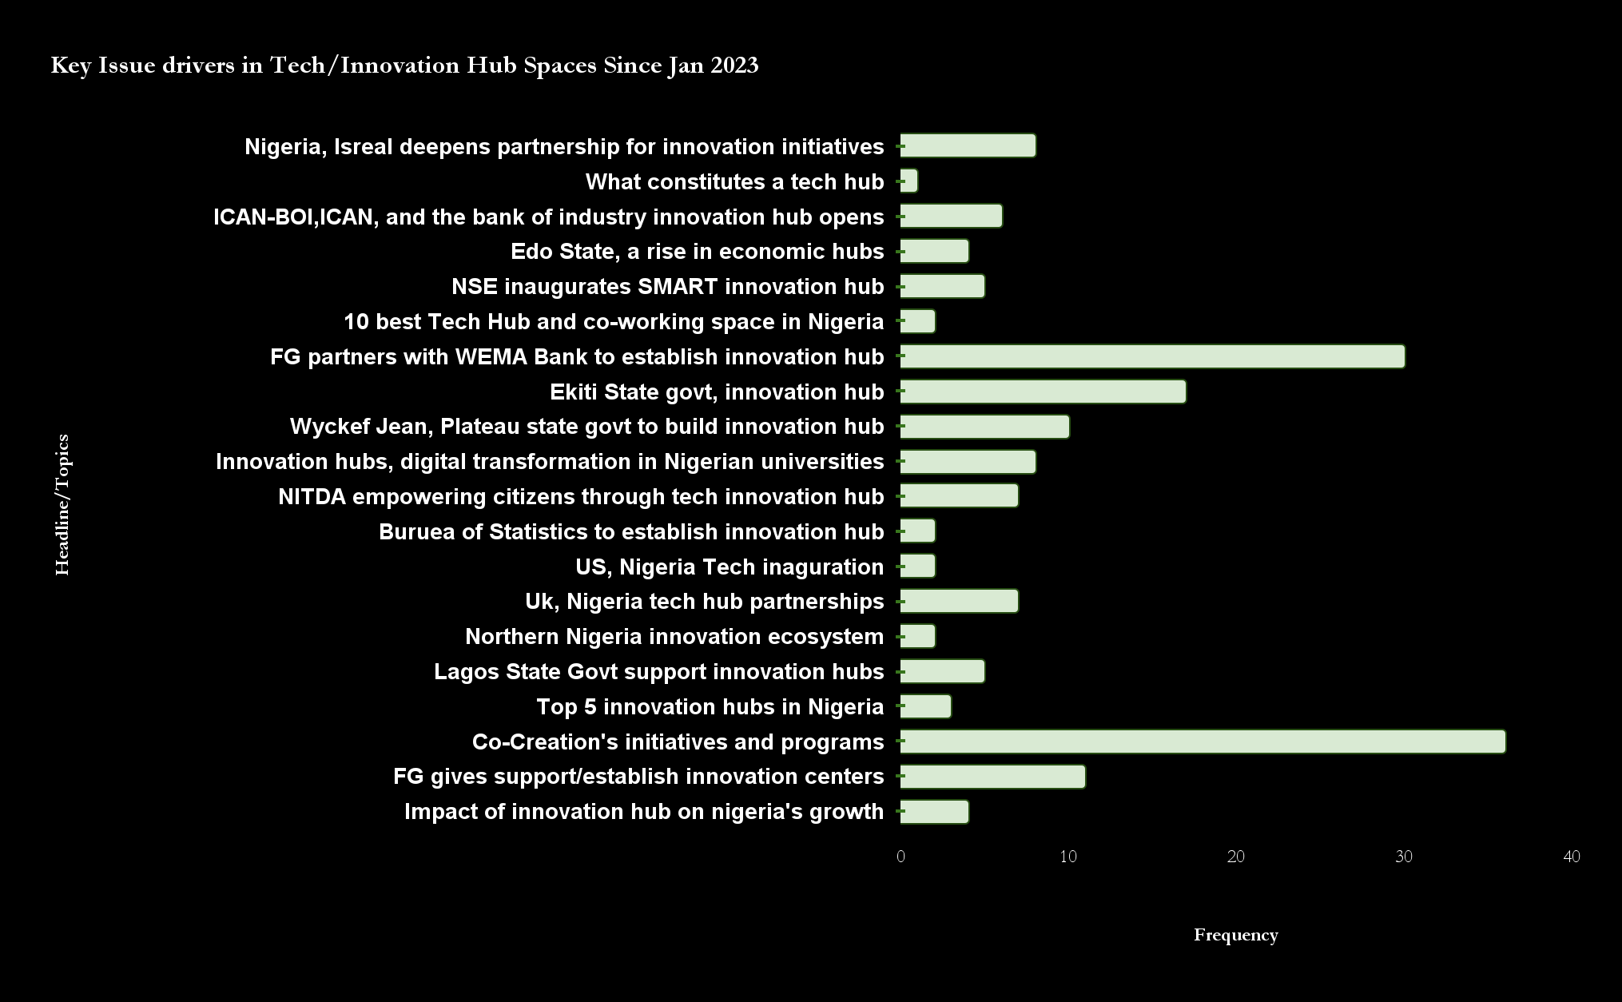
MEDIA ANALYSIS OF KEY ISSUE DRIVERS

Slide 10
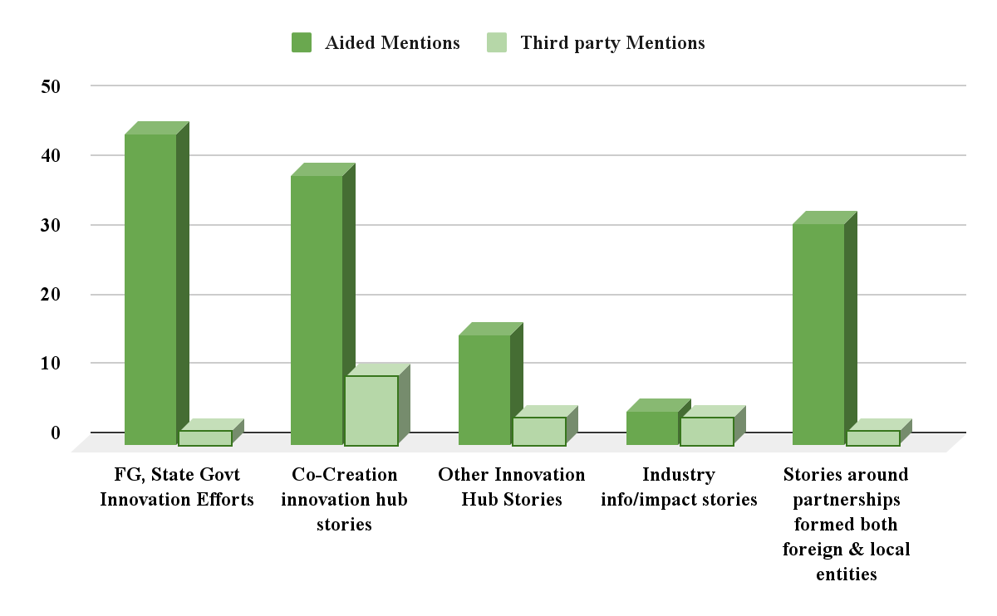
NATURE OF STORIES

Slide 11
TAKE OUTS | IMPERATIVES
Nigeria has witnessed a surge in technology hubs across major cities and an Increase in government support and initiatives Co-creation hub has the most media presence, the combined media presence of all other hubs still doesn't compare There’s need to develop a more unique angle to stand out from competitions Need to create, a strong network/commitment community in the ecosystem Most hubs are concentrated in south, leaving a gap in the central and northern regions. There's a growing interest from the media in social impact alongside for-profit ventures. There’s less focus on underserved sectors like agritech and cleantech Support for later-stage Startups is limited There’s high rise of collaborations and partnerships in the industry | Develop a clear and consistent brand identity that resonates with the target audience. Leverage the regional gap to become a regional innovation leader Build a strong alumni network/ community Form strategic partnerships with corporations in relevant sectors who might be interested in supporting innovation and development as part of their CSR initiatives. Use success stories of startups supported by the hub to build trust and showcase credibility Use targeted programs catering to specific industry sectors or stages of startup development. Offer multi-stage support and leverage that in the media Specialise in underserved sectors beyond typical tech-focused areas Partner with universities, research institutions, established hubs, and industry experts to expand resources and opportunities. Showcase how the hub supports ventures addressing local challenges like poverty, unemployment, or access to education.

Slide 12
OPPORTUNITIES FOR ILORIN INNOVATION HUB
Ilorin's central location positions it strategically to support agritech and cleantech ventures addressing regional challenges in agriculture, renewable energy, and sustainable development.
Focus on Deep Tech & Hardware: cater to startups in robotics, artificial intelligence, Internet of Things (IoT), or hardware development. Collaborate with universities with engineering programs to provide specialized resources and mentorship.
Engaging with international investors and innovation networks to attract global talent and funding.
Collaborate with universities to offer internship programs, joint workshops, and access to research facilities for startups.

Slide 13
PLANNING

Slide 14
COMMUNICATION OBJECTIVES
MARKETING OBJECTIVES
Generating Awareness on the activities of the hub and its unique value proposition amongst relevant stakeholders
Use communication channels to showcase the hub's importance and impact on social and economic development to Nigeria’s economy
Position the hub as a leader in fostering innovation in the country
Arm key stakeholders with the knowledge required to participate in the hub's programs and initiatives
Grow participation of students, graduates and tech enthusiasts in the Hub’s programmes
Secure funding and partnerships to support growth and sustainability

Slide 15
KEY STAKEHOLDERS
Groups | Who They Are | Desired Action
CORE AUDIENCE
Potential investors | Private organisations High-tech corporations (international) | Funding for accelerators Project investments
Potential partners | Higher institutions(local and international) Research institutions (local and international) High-tech corporations (international) Government | Mentorship for incubators Event partnerships / participation / sponsorships Partnership on initiatives Endorsements
Tech participants | Students Graduates Tech enthusiasts Startup founders | Participation in the Startup Growth Programme and Tech Skills Programme
SECONDARY AUDIENCE
The Media | Tech and ICT, Business, News | Dissemination of accurate information
Others | General Public | Good perception of the hub Advocacy (recommendations/referrals)

Slide 16
STAKEHOLDER | NEED | MESSAGING | HOW THEY CAN BE REACHED
Young students and graduates | Skills development, mentorship, internship opportunities, access to funding for student ventures. | Highlight programs that equip students with entrepreneurial skills, emphasize internship opportunities with innovative companies. Emphasize the hub's role in fostering a vibrant innovation ecosystem for aspiring founders | Articles, news reports, Ads, Events
Startup Founders | Need funding, co-working space, and technology infrastructure. Mentorship from experienced entrepreneurs and industry experts. Networking opportunities with potential investors, partners, and customers. | Communicate the hub's support for startups in underserved sectors relevant to the region. Position the hub as a launchpad for scaling startups and connecting them with the right networks. | Events, Articles, news reports, bootcamps and workshops, Ads
Investors | High-potential startups with strong growth potential, access to a deal flow of investable ventures, and a supportive ecosystem for startups. | Share data on the success rates of startups supported by the hub to demonstrate a strong track record. Position the hub as a reliable source for identifying and investing in promising | Seminars, webinars, articles, news reports. conferences and workshops, Ads, one-on-one engagements

Slide 17
STAKEHOLDER | NEED | MESSAGING | HOW THEY CAN BE REACHED
Higher Institutions | Evidence-based solutions for social and economic challenges, alignment with regional development goals, job creation, and positive social impact. | Communicate the hub's focus on connecting startups with economic and societal challenges, emphasize opportunities for research, co-creation and collaboration with startups, and highlight the talent pool available through the hub's programs. | Articles, news reports, seminars, workshops, conferences, Ads
Corporate & Public Sector Partners | Access to cutting-edge solutions, opportunities to collaborate with innovative startups, talent acquisition pipelines, and positive brand association with innovation. | Communicate the hub's focus on connecting startups with industry challenges, emphasize opportunities for co-creation and collaboration with startups, and highlight the talent pool available through the hub's programs. Showcase the hub's commitment to building a diverse and skilled talent pool. | Seminars, webinars, articles, news reports. conferences and workshops, Ads, one-on-one engagements

Slide 18
STRATEGY
To become an indispensable force within the lives of our target audiences, empowering them to achieve their entrepreneurial dreams and aspirations through consistent support, resource access, and meaningful engagement.
Differentiation
Do what competitors don’t do: Cultivate a community where we engage with target audiences on a deeper level, understanding and supporting their entrepreneurial dreams and aspirations.
Reputation
Establish authenticity from the very beginning: A face behind the brand and Positioning as a highly reputable platform
Relevance
Position the hub as a solution driven organisation. We will focus on communicating the efforts and impact of the Ilorin Innovation Hub in a way that clearly shows their achievements in doing this

Slide 19
THEME
Core Message
Ilorin Innovation Hub is home to new ideas, helping to nurture and bringing them to reality
A centre for solving real problems that will lead to growth and development
1
Innovation | for People & Economy
2
Making Innovation Work
Message Pillars
Innovation & Entrepreneurship
Youth Empowerment
Tech & Economic Development
Ilorin Hub Impact

Slide 20
ACHIEVING THE STRATEGY
Differentiation
Build a tech community/alumni community
Reputation
Executive profiling
Influencer leveraging & social media engagements
Thought Leadership
Events & conferences
Relevance
Use home grown solutions to address local issues

Slide 21
PR IMPLEMENTATION

Slide 22
PRE-LAUNCH PHASE

Slide 23
ROLL OUT
Pre-Launch Phase: April- June 2024
Launch Phase: July - Aug 2024
Sustenance Phase: Jan ’25 onwards
Spokespersons Media Training
Building media Loyalty group
Agenda setting
Executive profiling
Influencer engagement
Launch event
Stakeholders Outreach
Strategic Content Development
Editorial content series
Thought Leadership
Radio/TV appearances
Social Media amplification
Building Profile and Reputational Stature:
Building a community series
Special reports
CSR Engagements
BI-annual Event & Conference
Third Person Media
Milestone leveraging

Slide 24
SPOKESPERSONS MEDIA TRAINING
The objective is to empower Top Executives and other authorised spokespersons with the basic skills required to handle various media related situations when engaged by the media
This is will be a few hours session encompassing discussions on media nuances and simulated interview session on various media engagement scenarios
Training Overview
Date: | Time:
Section 1: Media Photo Shoot
Media Portrait Photo
Full official and Casual official
Interview mode Photographs
Media Photo & Photo news nuances
Section 2 (Module a -Discussion)
The Nigerian Media:
The Overview and Landscape
Media nuances
Spokespersons role in media engagements
Section 2 (Module b -Discussion)
Having successful media engagements
Steering the discussion in media engagements
Dealing with difficult journalists and questions
Interview preparation and discussions
Section 3: Role Play
Introduction and backgrounder
Realistic simulated interviews
Playback and evaluation of the interview
Role Play Set/Prop and Video Coverage:
The role play is a simulation of
Print Journalist Interview
Real life simulation TV or Radio interview.
The setup will mimic a typical TV/Radio Studio
Video coverage of the interviews for replay and review

Slide 25
MEDIA LOYALTY GROUP
One-on-one briefing with media members before, during and after the launch
Co opt media members from the launch into a media loyalty group
Regular interaction with members
Provide frequent updates and engagement on developments on the hub
Proactively assist with management of negative reportage
Counter to negative stories when existent

Slide 26
TARGET MEDIA SUPPORT GROUP
Radio
Lagos Talks
Nigeria Info
Wazobia FM
Inspiration FM
Brekete FM
Yes FM
Bond FM
Lagos Traffic Radio
Television
Channels TV
TVC
Social media
X (formerly Twitter)
Facebook
Instagram
Linkedin
Tik Tok
YouTube
Newspapers (print and online)
Guardian
Punch
Businessday
Thisday
Daily Independent
Vanguard
Tribune
Leadership
Daily Trust
Sun
The Nation
New Telegraph
Blogs and News Sites
Tech Economy
Tech Point
Tech Cabal
PM News
PM Express
The Cable
Premium Times
Legit
Bellanaija
Nairametrics

Slide 27
AGENDA SETTING
Set the tone of the campaign by starting discussions around the hub, the importance of innovation hubs and the challenges the hub hopes to solve
Content Direction
highlight the hubs focus on supporting startups in underserved sectors
Emphasise its aim in connecting startups, universities, investors, etc
Tools
Interviews with top tier media to provide in-depth discussions
Articles, which will be generated internally and shared with select media to leverage the interview discussions
News stories to leverage the interviews and extend the reach of the discussions through national newspapers
Platforms
Interviews
Businessday
Guardian
Business Insider Africa
Arise TV
Articles (generated from interviews)
Nairametrics, The Cable, TechCabal, Legit & BellaNaija
News stories (generated from interviews)
National newspapers (print & online)

Slide 28
EXECUTIVE PROFILING
INFLUENCER LEVERAGING
Project the leadership behind the hub and leverage their strength to build credibility and trust
Profiling articles which will focus on their pedigree and vision for the hub
Interviews on their perspectives on innovation trends within the industry
Interviews to be in Channels TV, TVC
Articles in tier one publications - Thisday, Guardian, Businessday
Leverage one famous tech influencer to further create awareness around the hub.
Live stream tour of the facilities
Emphasise the different offerings and objectives of the hub, etc
This will be used to start a social media campaign to draw attention to the hub and its upcoming launch

Slide 29
LAUNCH PHASE

Slide 30
LAUNCH EVENT
The Event
A major stakeholder launch event that would take place at the Ilorin Innovation Hub
The event will have key stakeholders in attendance, drawn from Tech organisations, industry trade organisations, investment partners, government, students, graduates and tech enthusiasts
The event will be used as an opportunity to advance the discussion on the import of growing capacity in innovation and tech skills for rapid advancement
Event Style
A panel discussion will be incorporated into the event, where select stakeholders in the industry and government will discuss the import of growing capacity in innovation and tech skills for rapid advancement and the role the Hub will play in the mix
A facility tour of the Hub will be incorporated into the launch event to give the guests an experiential feel of the Hub
Agenda
Welcome and introduction
Tea / breakfast
A description of the features of the Hub
Panel discussion
Symbolic launch of the Hub by the Kwara State Governor
Facility tour of the Hub
Launch
Departure

Slide 31
MEDIA LEVERAGING
STRATEGIC CONTENT DEVELOPMENT
Media leveraging of the event will commence immediately.
media attendance will include national newspapers for online publication, TV coverage, radio coverage, live posts by a team social media influencers
Output will include:
Online news publication
Social media advocacy
Feature articles
Radio news broadcast
Tv news broadcast
A series of feature articles will be developed and deployed by the media support group.
Analysing the activities of the hub and its impact in the community and beyond, for example:
Total number of Startups reached
Impact on job creation, entrepreneurship with the region and beyond
The Programmes, speakers on each program, collaborations etc
Workspace/startup/community member features
Articles will be used to develop news stories in print and online mainstream newspapers and online blogs, to be be published in;
Print and online mainstream media - Guardian, BusinessDay, Leadership, Tribune, The Nation
News sites and blogs - PM Express, The Cable, Premium Times, PM News,
Contents will be further leveraged as news reports and published in online blogs (tier 1, 2, 3)

Slide 32
RADIO/TV APPEARANCES
Organise radio and TV appearances for media spokesperson to further amplify the message and maintain public awareness.
Content direction | Platform
Radio: Monthly appearances to shed more light on the activities going on around the hub | Royal FM Unilorin FM Diamond FM Kwara Radio Lagos Talks Nigeria Info
TV: Interviews and discussions highlighting the hub’s aims and present achievements | Channels TV TVC
News reports will be issued to highlight the discussions across various media platforms: Punch, Sun, New Telegraph, Daily Trust, Daily independent.

Slide 33
THOUGHT LEADERSHIP
Leverage the leadership team to drive conversations around pertinent industry issues and topics of interest to stakeholders, enhance visibility amongst both local and international business communities.
Lead Industry conversations.
Accept pro bono speaking. engagements and opportunities on areas of expertise and public interest
Agency will provide ample publicity to these and other activities.
Activities will be done via interaction with the media and stakeholders in the business sphere.
Leverage thought leadership opportunities further in the media via stories publications and social media.
Interviews
Event speaking opportunities
Op eds
Collaborative webinars
Media Targets: Tech, Business,
Print: BusinessDay, Guardian, Thisday, Daily Trust, Punch, Tribune and Leadership,
Electronics: Channels, TVC
Online blogs and sites: Tech Cabal

Slide 34
SUSTENANCE PHASE

Slide 35
BUILDING PROFILE AND REPUTATIONAL STATURE
This is needed to boost the confidence of prospects, partners and key stakeholders in the leadership of the brand
Long Term Outlook
Be media-friendly and accessible
Lead conversations around tech/innovation industry issues in the media
Position as Thought-Leader across key sectors by sharing knowledge via special reports
Lead discussion and set agenda in areas
Activities:
Special reports
Events and conferences
CSR engagements
Third party media
Milestone leveraging

Slide 36
CONNECTING WITH YOUTHS
Connecting via Wifi
Set up a 2-hour free-wifi access in public places including universities, Ilorin Mall, Major Motor Parks (student populated) and Gov office.
We will promote this “free Wifi” initiative on key Radio Stations in and around Ilorin metropolitan.
To access the 2-hour free-wifi, the banner/page showing information on the Hub will appear for 30” seconds
This will be used to create more awareness about the Hub.

Slide 37
SPECIAL REPORTS
Agency will work with the team to put together a Quarterly report that evaluates some key areas
The report will be chronicling data on trends, perceptions, challenges and prospects within the identified market sectors.
Agency will generate content from the report to highlight untapped areas of opportunities for media publications with reference to Ilorin innovation hub
Releasing quarterly data/infographics on market intelligence gathered through research.
To increase media output, the report distribution will be targeted at key media platforms across mainstream and online (Local & International)

Slide 38
ANNUAL EVENT & CONFERENCES
Host a bi-annual event to bring together industry experts, government, universities to collaborate and share ideas and educate the general public on topics within the context of reaching more people and creating collaboration and networking.
E-Government Hackathon in partnership with FMCIDE & Devs in Government Community
A webinar version will take place simultaneously to reach more people
Events will be milked for content in print and online newspapers and online blogs using:
Press releases
Feature articles

Slide 39
CSR Engagement
Third Party Media
Milestone Leveraging
Demonstrate commitment to the social and economic development of host community and Nigeria at large and command endearment towards the brand
Programmes will be built around AgriTech, EduTech, HealthTech development:
Capacity building programmes in technology
Annual Hackathon
Leverage Media Loyalty Group to drive:
Stories on the impact of the hub’s services and activities on individuals, the community as well as socio-economic development
Human angle success stories
Leverage the positive developments surrounding he hub in the media such as:
New partnerships
Awards
This will be leveraged via:
Press releases
Feature articles
Interviews
Photo stories where applicable

Slide 40
BUILDING A TECH COMMUNITY
Start a community made up with members from across the key stakeholders. This will serve as a community loyalty group for the hub
It will serve as a place for sharing information and brainstorming for forward thinkers.
Regular interaction within this community will be used to;
Disperse important news beyond the circle of the community far reaching into the innovation ecosystem
Exchange ideas on industry trends
Proactively assist with attracting new members
Build credibility and trust in Ilorin hub as the best source to learn and launch new ideas
Launch community platform with news, events, courses and social interaction
“BUILD A COMMUNITY SERIES” or “TECH-TRIBE” as a monthly article series
To give industry related news, pass info about opportunities for startups and young graduates, new areas of focus in the ecosystem

Slide 41
BUILDING A TECH COMMUNITY
This community can spread out to reach university and secondary school students, eg:
Collaborate with secondary schools in the region to create a new school club (tech club) for youngsters with deep interest in tech, highlighting how they can pursue their goals even though they are still in secondary school.
Periodic competitions and games can be sponsored by the hub to give these young ones a stage
Collaboration with universities for undergraduates to also form a school club (Tech_UG) to form an alumni community for sustainability.
All these different groups will also use the TECH-TRIBE websites for information and discussions with likeminds.
Contents for the monthly series can be drawn from issues raised from the community websites

Slide 42
MARKETING PLAN

Slide 43
MARKETING FRAMEWORK
Ad Campaign
Digital Marketing
Events
Initiatives and partnerships

Slide 44
DIGITAL MARKETING

Slide 45
SNAPSHOT
Content Pillars
Framework
Distribution
Channels
Innovation & Entrepreneurship
Youth Empowerment
Tech & Economic Development
Ilorin Hub Impact
Engagement campaigns
Digital Ad Campaigns
Activities amplification
Storytelling
Ilorin Hub platforms
Ads / Boosting
Audience & Platforms - Earned
Third party advocacy / partnerships
LinkedIn
Facebook
Twitter
Instagram
Google
Tik Tok
Youtube
Ilorin Hub Platforms
Website
Facebook
X
Linkedin
Instagram
Newsletter

Slide 46



Engagement Campaigns
Pre-launch conversations
Launch
Post Launch
Set the agenda by inspiring conversation on selected issues in the society and how technology can play a role in delivering solutions
Additionally discuss the role of Hubs in fostering technology solutions and how this can contribute to states and the nation
Lead the conversations through social media advocates
conversation areas will be taken from areas of interest of the Hub: agriculture, health, education and energy
#MakingInnovationWork
Drive awareness about the launch event via influencer partners, news and social media posts
Link the Ilorin Innovation Hub launch to the pre-launch conversation
Release collaterals with #IlorinInnovationHub, #MakingInnovationWork
Social media advocates will distil the import of the Ilorin Innovation Hub in line with fostering technology solutions (to the identified issues and areas from the pre-launch convo)
Distill the programmes of the Ilorin Innovation Hub and encourage
Enlist participants to share their experiences
Cover stories of community members and workspace activities via Youtube Series
Demonstrate and deploy solutions developed through the Ilorin Innovation Hub

Slide 47


DIGITAL AD CAMPAIGN
Awareness
Call To Action
Impact
The message will focus on the existence of the Hub; its features, mission and benefits
Formats: banners, carousels and videos
Ads will include a ‘learn more’ link leading audience to the website
Ads specific to the 3 core audience groups (Potential investors, potential partners and tech participants) will be developed
The messages will focus on the various programmes of the Hub, including
The startup growth programme
The Tech Skills Programme
Initiatives, events, competitions, etc
Ads will include CTA for registration / application
Ads in this category will focus on the tech participants
The messages will focus on the impact of the Hub on participants, the economy and society.
Testimonials by participants in video formats and social media posts, leveraged by influencers
video documentaries of the initiatives and programmes of the Hub
The Ads will focus on the 3 core audiences

Slide 48
ACTIVITIES AMPLIFICATION
The activities of the Hub will be leveraged on social media:
Training programmes
Event participation
Partnership deals
Projects
Innovations
etc
Tools:
Photos
Videos
Banners
Platforms
X (formerly Twitter)
Facebook
Linkedin
Instagram
Drivers:
Ilorin Innovation Hub platforms
Social media advocates
STORYTELLING
Consistently curate and drive stories about the Hub, its facilities, programmes and projects in connection to everyday people and problem solving
This provides an always-on approach for online presence for the Hub
Content will be leveraged on the Ilorin Hub newsletter, blogs and online news sites
Published stories will be further leveraged on the social media platforms of the Hub and its social media advocates

Slide 49
AD CAMPAIGN

Slide 50



Overview
An elaborate Ad campaign will be deployed post the launch of the Hub
Ads will be tailored to the core target groups
Designed and inspired by the selected theme
Key messages
Tech participants (students and graduates)
Join our community to learn new skills and build your career
Tech participants (Tech enthusiasts)
Join our community to see your ideas grow
Potential investors and partners
Join our community to foster the growth of technology and innovation
Radio
TV
OOH

Slide 51
RADIO AD
TV
Mode
Conversation style
Youthful and modern
60 secs length
3 months initial duration
Radio Stations
Royal FM
Diamond FM
Unilorin FM
Mode
Conversation style
youthful
60 secs length
3 months initial duration
Tv Stations
NTA
Channels TV
Kwara State TV

Slide 52
OOH
Location Selection
Out-of-Home will be deployed within Kwara State and its environs
Targeted locations will include
within and around tertiary institutions
Highways
Formats
Billboards
Lamp posts

Slide 53
EVENTS

Slide 54
EVENTS
To increase brand visibility and positioning, Ilorin innovation hub can facilitate connections between members, investors and industry leaders through networking events.
Host a monthly “Innovation Meet-up” with guest speakers, either local or international or sponsor relevant industry events like conferences, seminars or Tech-Fests and create buzz around the these events.
Host workshop events on specific topics relevant to innovation like
Design thinking
Business model development
Demo/Pitch events ( a quarterly event where members of startups present their ideas to a panel of investors, angel investors and receive valuable feedback)
Training sessions
Attend industry events and secure speaking opportunities to showcase the hub’s expertise in the industry. Some potential events are:
Event | Description | Location | Date
Africa Technology Expo 2024 | Engage with industry experts, entrepreneurs, and enthusiasts in discussions on the future of technology in Africa featuring interactive demos, engaging presentations, and insightful panel discussions. | Lagos, Nigeria | June 22nd, 2024
Africa Startup Festival | This event is mostly a networking opportunity for investors and startups with speaking and exhibition opportunities. | Lagos, Nigeria | November 11, 2024
Africa Tech Festival | Connect with Africa's tech and business sectors for a inclusive digital continent | Cape Town, South Africa | November 11-14, 2024
MWC Kigali 2024 | Exploring how mobile technology and digital solutions can address challenges and create opportunities in Africa, covering topics like 5G, FinTech, the digital economy, and health tech. | Kigali, Rwanda | October 29 – 31 2024

Slide 55
INITIATIVES & PARTNERSHIPS

Slide 56
INITIATIVES & PARTNERSHIPS
Form partnerships with universities, private and and public corporations, government and NGOs to offer tailored programs for startups, connect with student entrepreneurs, resource sharing and access to industry networks.
These initiatives can be advertised and promoted through our different media channels.
Co-host hackathons or innovation challenges for students with universities
Develop joint research projects with universities with focus on areas like; solutions in renewable energy, agriculture, and healthcare
Partner with government agencies to launch a grant program for innovative startups with social impact.
Partner with innovation hubs in other countries to co-organise online workshops, webinars on cross-border innovation challenges or for startups looking to expand into new markets
Partner with local businesses to recruit mentors and connect them with hub members
Collaborate with a bank to offer financial literacy workshops and “Startup Loan Package” with preferential rates for hub members

Slide 57
BUILDING AN INTERNATIONAL PRESENCE
Highlight the hubs potential for international collaborations and the diverse range of innovative startups present by highlighting stories of hub members tackling challenges with global relevance.
Other
Host virtual or in-person conferences, workshops, and webinars featuring international speakers and attracting participants from diverse backgrounds on a topic that is relevant to both regions
Nominate top startups in international competitions
Collaborate with international organisations like; MIT, Google, Microsoft etc to run innovation challenges across africa
Use ads on social media platforms like LinkedIn, which has global presence in the business community will attract international attention.
Include in our social media campaign the hashtag #Africainnovates in all the posts relating to the hub
Use blog Posts headlines that highlights the unique value/impact of the hub on a topic with international relevance e.g “The rise of Agritech Startups in Nigeria and how Ilorin innovation hub is supporting them”
“Innovate from anywhere challenges” - share your innovation solution for a global problem and win a virtual incubation session at Ilorin Innovation Hub.

Slide 58
Media Monitoring
Measurement
Benchmark
Qualitative:
Representation of key messages in reports
Influence of medium (credibility rating; readership / viewership / listenership)
Positioning of stories/photos
Quantitative:
Volume of coverage
Share of voice in the print, and online media
Sentiments / Tonality
Constantly monitor print and online to track stories and commentaries
Watch for and quickly react to any adversarial issues as well as environmental factors.
Reports and clippings sent to Client.
Degree of Balanced/positive press reports/features on all activities
100% web surveillance with reports on online mentions and reputation tracking
Availability of up to date press materials

